Slide 1

Recommender Systems
By- Ananya Sharma
Amazon- Fashion Products

Slide 2
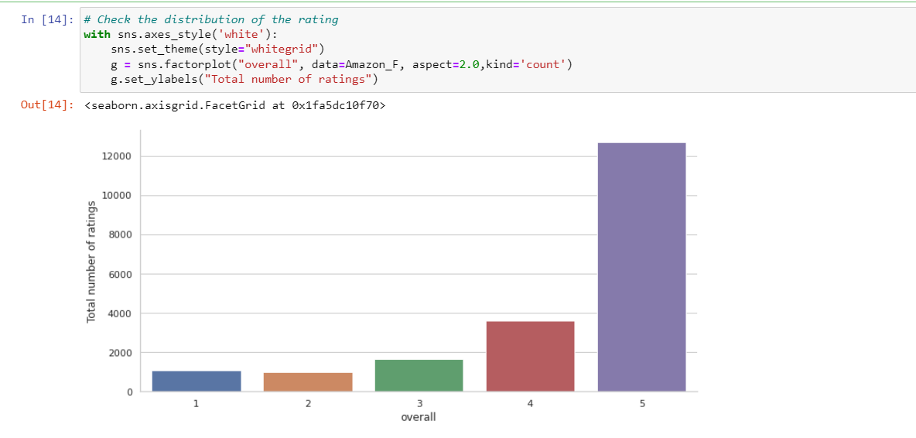
EDA- Ratings based Recommendations

Slide 3
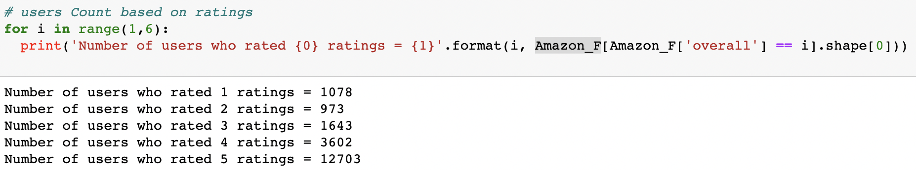
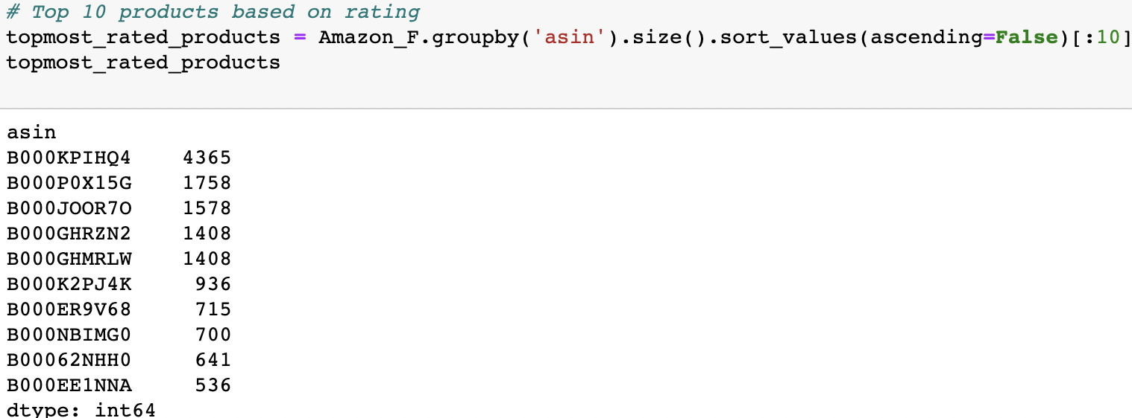
User count and top products based on Ratings

Slide 4
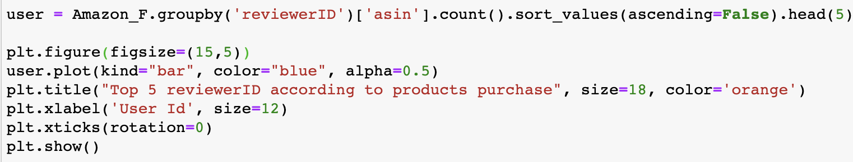
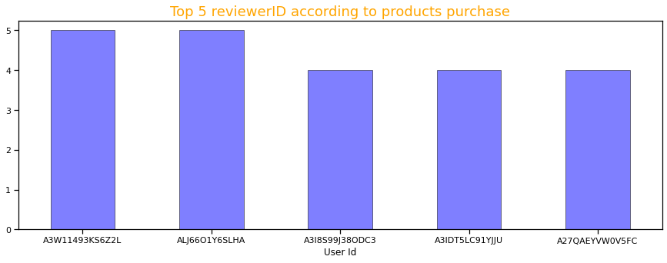
Top 5 user ID and the count of Products Purchase

Slide 5
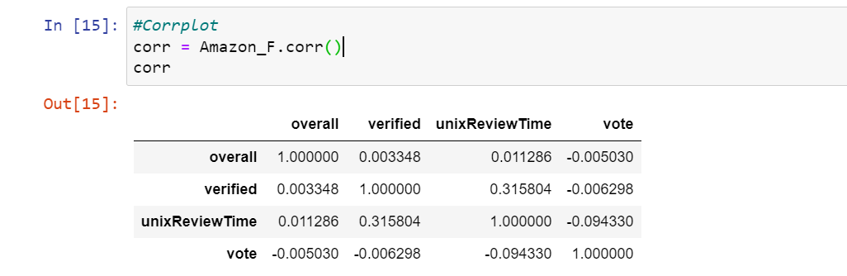
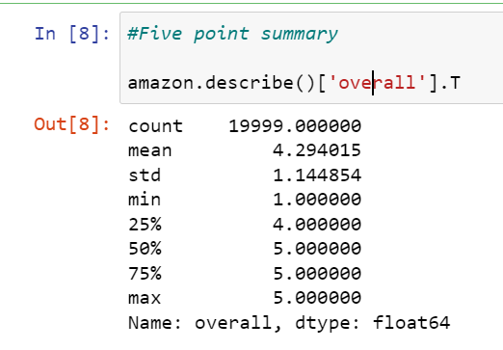
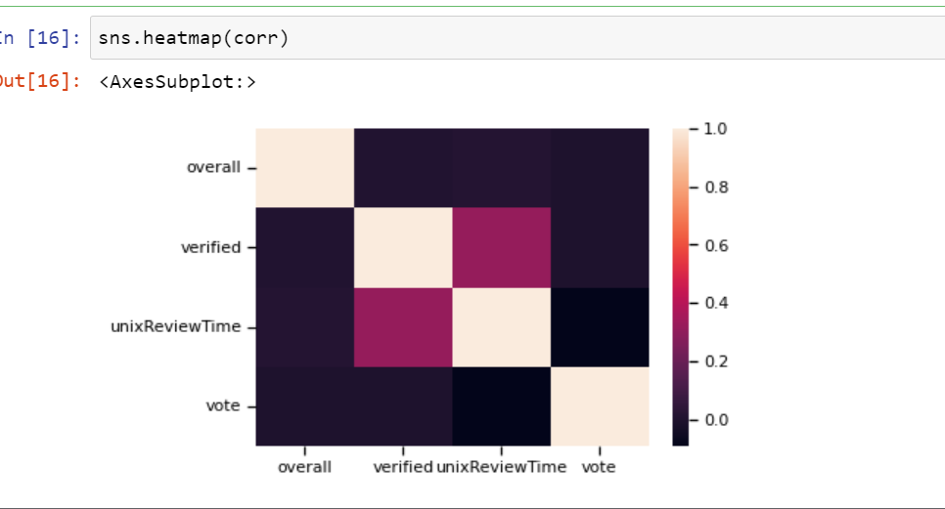
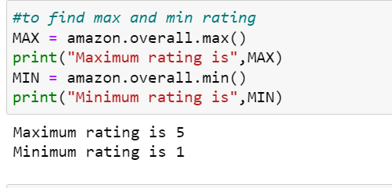
Descriptive Analytics
Summary
Correlation

Slide 6
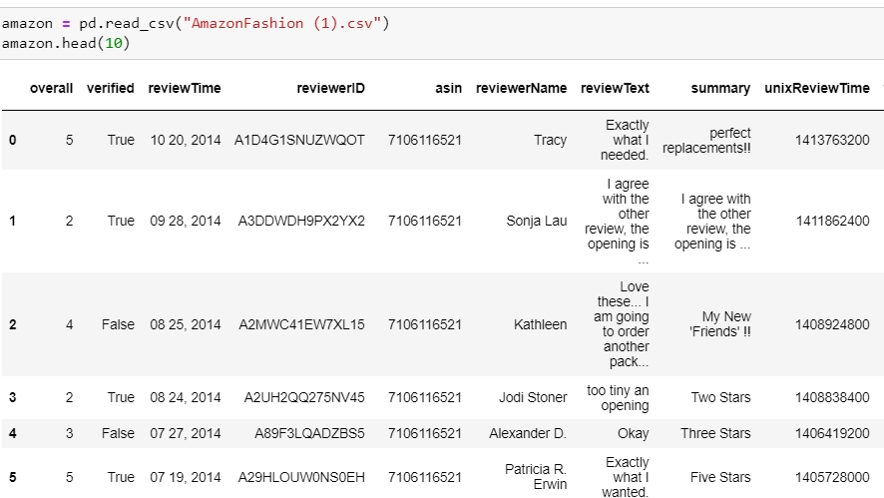
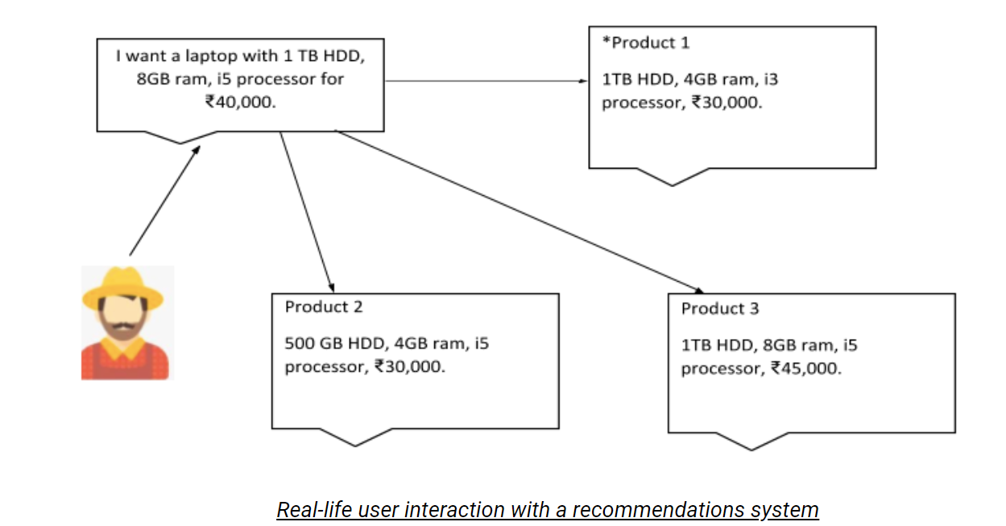
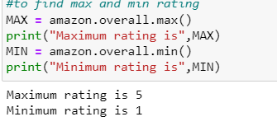
Popularity Based Models
No cold start Problems
Recommends the most popular products
Not a personalized solution
Generic approach to recommendation

Slide 7
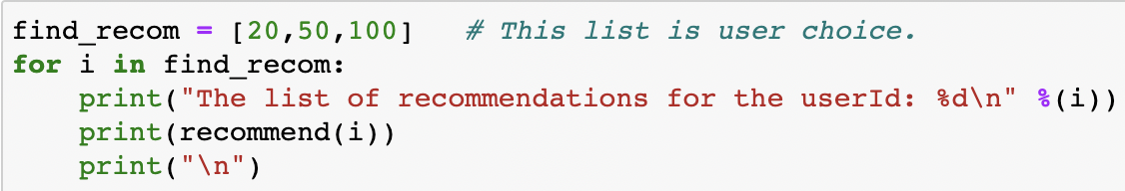
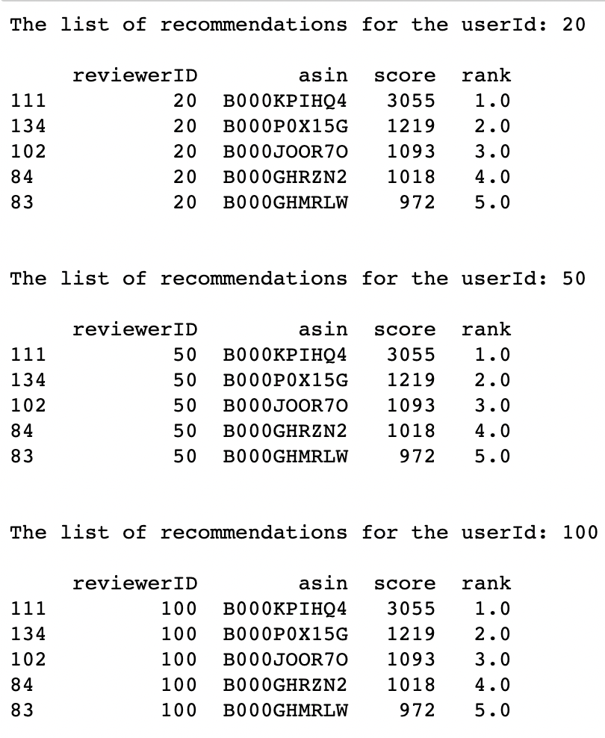
Predictions Based on Popularity based recommendation

Slide 8
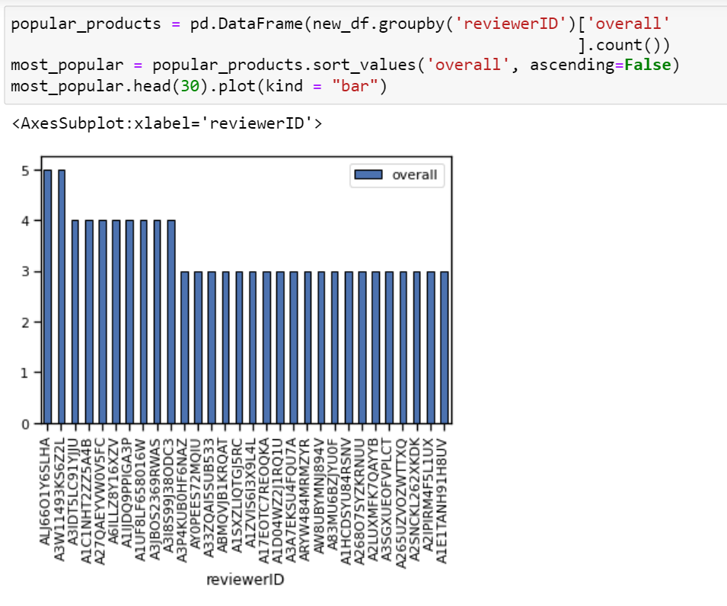
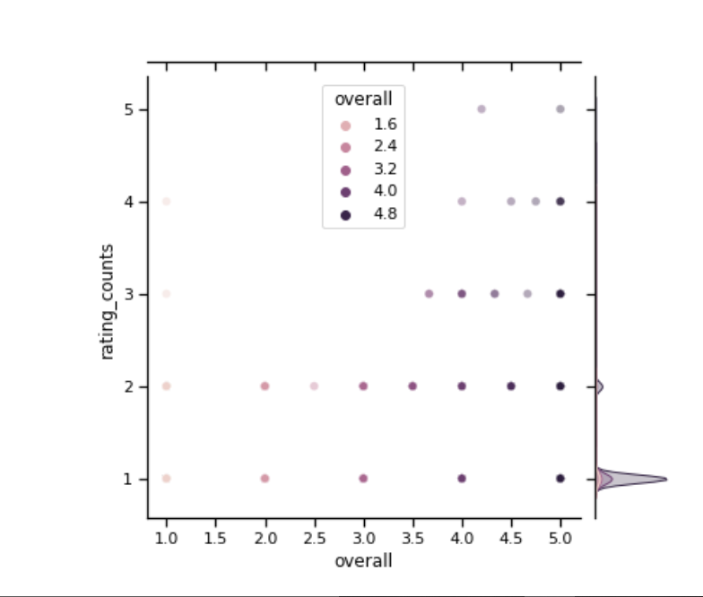
Bars & Joints

Slide 9
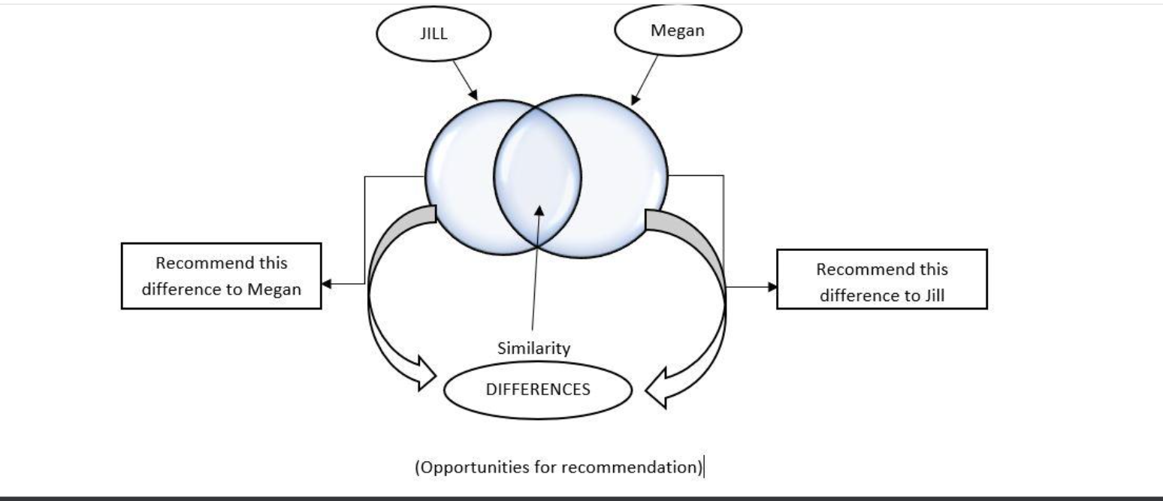
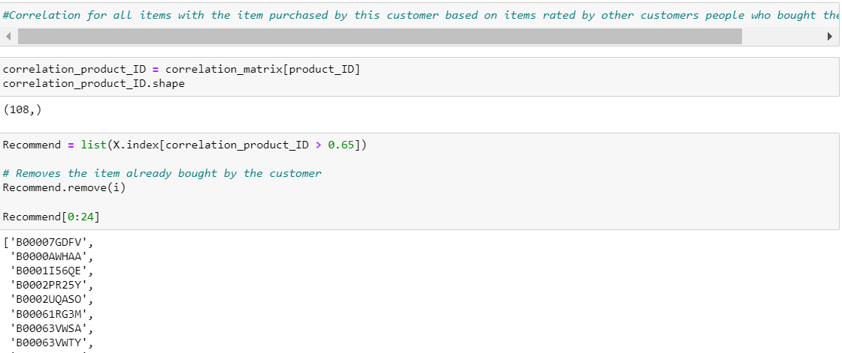
Collaborative Based Models
Item-Item Based approach
User Based Approach
Works on popular products as well as user’s choices
Correlation Matrix Based approach

Slide 10
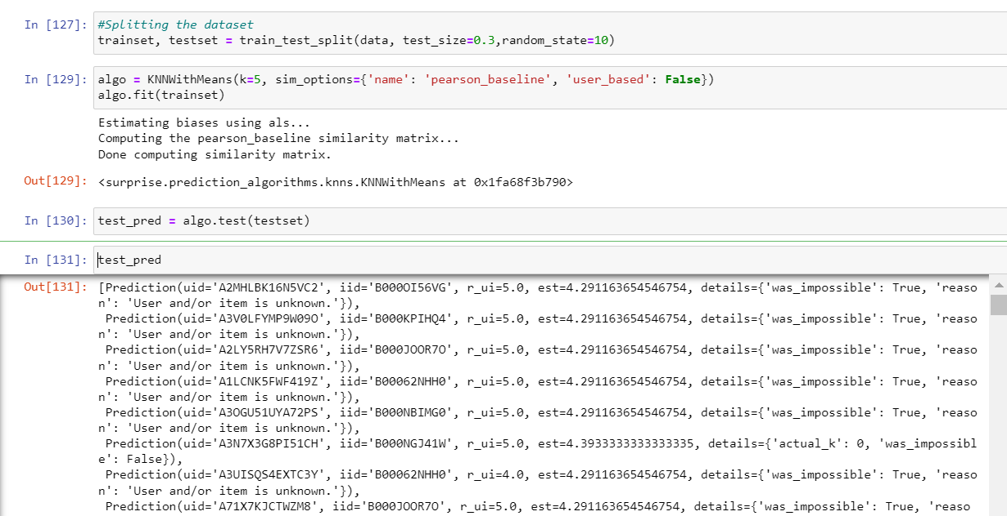
Test and Train with KNN means-Collaborative Method

Slide 11
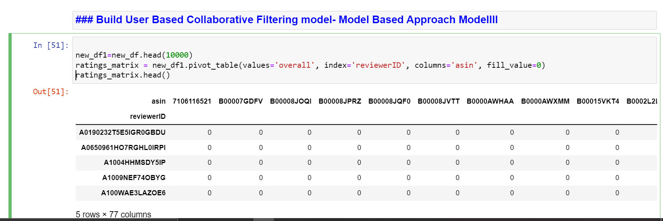
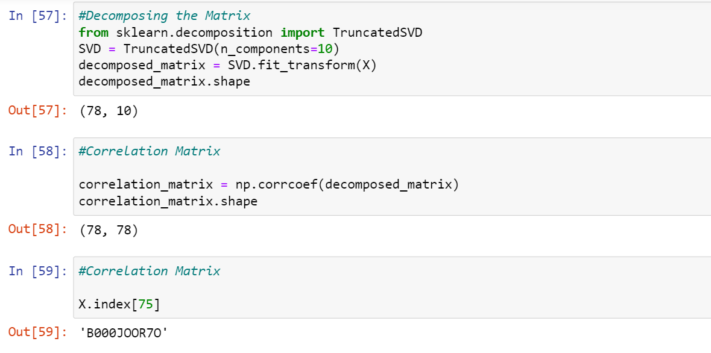

Slide 12

Questionnaire??
Conclusion
The RMSE for the model is 1.04, which is on the higher end. RMSE in recommendation system with low values are considered good.
Three major Recommender systems used: Content-Based, Collaborative Based, Popularity Based
KNNmeans method used with test and train model
Most of the variables(columns) don’t have a direct correlation among them
ALJ6601Y6SLHA is one of the most popular products

Slide 13


Slide 14
References
Umamaheswaran, V. (2018, November 14). Comprehending K-means and KNN Algorithms - Becoming Human: Artificial Intelligence Magazine. Medium. https://becominghuman.ai/comprehending-k-means-and-knn-algorithms-c791be90883d
Jalili, M., Ahmadian, S., Izadi, M., Moradi, P., & Salehi, M. (2018). Evaluating Collaborative Filtering Recommender Algorithms: A Survey. IEEE Access, 6, 74003–74024. https://doi.org/10.1109/access.2018.2883742
Z. (2021, May 10). What is Considered a Good RMSE Value? Statology. https://www.statology.org/what-is-a-good-rmse/

